Slide 1
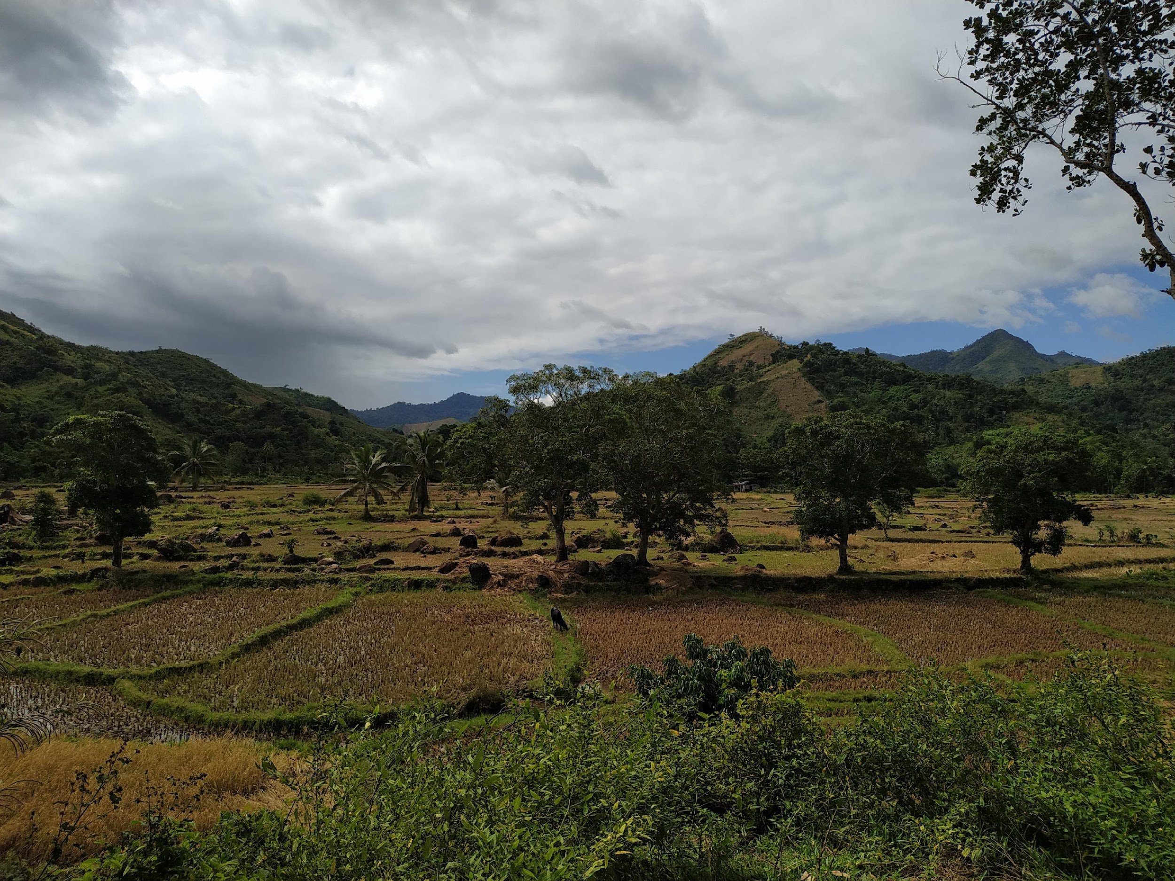
Distinct drivers of host-microbe network structures for core and rare microbes along a land use change gradient
Matan Markfeld, Georgia Titcomb, Charles Nunn, Shai Pilosof
September 2024

Slide 2
The microbiome is crucial for host health and function
It might alter disease dynamics
Therefore, it is important to understand the processes and factors that shape the microbiome
Especially in rodents that are a major reservoir of zoonotic disease agents
Berg et. al., 2020; Rosenberg & Zilber-Rosenberg, 2018

Slide 3
Anthropogenic land use change, including the conversion of natural areas to agricultural or urban ecosystems, alters the environment and the conditions in which the host microbiome is shaped
Two categories of processes: deterministic and stochastic
Deterministic: environmental filtering (due to diet shift)
Stochastic: dispersal between individuals (population density and behavior), dispersal from species pool (changes with the environment), neutral processes and drift
Newbold et. al., 2015; Bernardo-Carvo et. al., 2020; Fackelmann et. al., 2021

Slide 4
Functional roles may vary between microbial groups (core and rare)
Different processes at different scales may drive the distribution of different groups of microbes

Slide 5
While most microbiome research focuses on humans or domestic animals, we still don’t know a lot about wild animals and how environmental factors, such as land use change, affect their microbiome
Bernardo-Carvo et. al., 2020; Fackelmann et. al., 2021

Slide 6

We can explore the host-microbe network structure
The network depict the interactions between hosts and bacteria
Benefits of representing the system as network
The network’s structure is a signature of the processes that shaped the network
For example modularity (however, see Dorman et al, 2017)
Microbes
Hosts
Agroforest
Rice
Forest

Slide 8
Research questions
Q1. What processes shape host-microbe community structures along a land use change gradient?
Q2. How do core and rare microbial groups differ in these processes?

Slide 9
Hypotheses
H1. Neutral processes
H2. Processes at the local scale (within land use)
H3. Processes at the land use scale
H4. Interaction between microbial group and H1-3

Slide 10
Filtering the microbiome
Rattus from 3 villages
Feces – gut microbiome
Bacteria ASVs
Relative reads abundance > 0.1% per sample
Prevalence > 1%
Total reads in a sample > 5000
Taxonomy

Slide 11
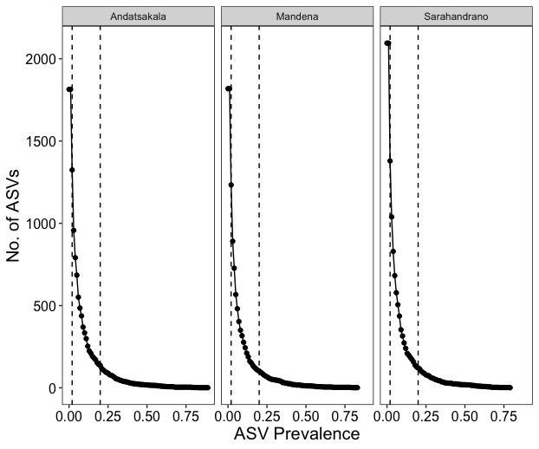
Microbes' prevalence
3 groups:
Rare [1%-2%]
Non-core [2%-20%]
Core [>20%]

Slide 12
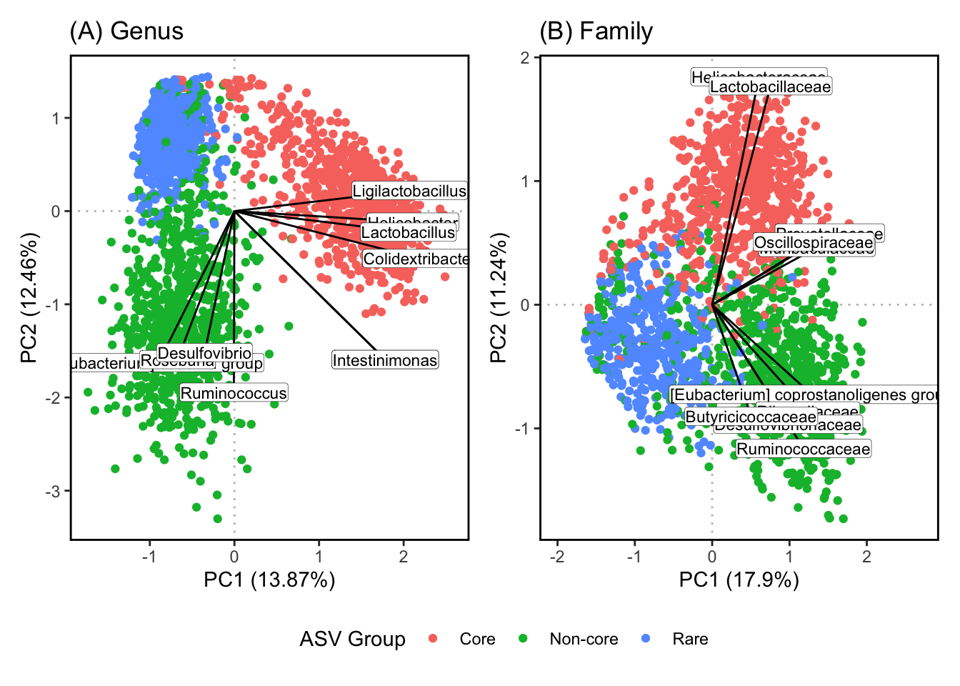
The groups represent different microbial genera and families (and potentially functions)

Slide 13
Bipartite network between host individuals and bacteria ASVs
Link’s weight = ASV relative abundance
Infomap
Microbes
Hosts
Agroforest
Rice
Forest

Slide 14
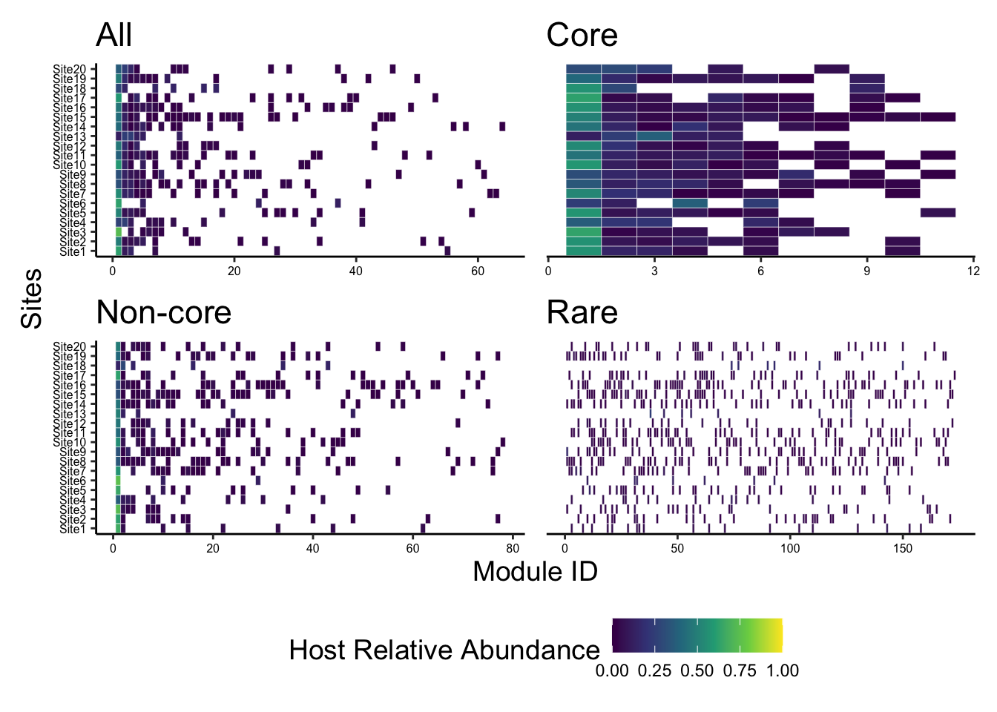
Community detection - Infomap

Slide 15
The network has more and smaller modules (core -> rare)
For core and non-core there is a single big module that span all sites

Slide 16
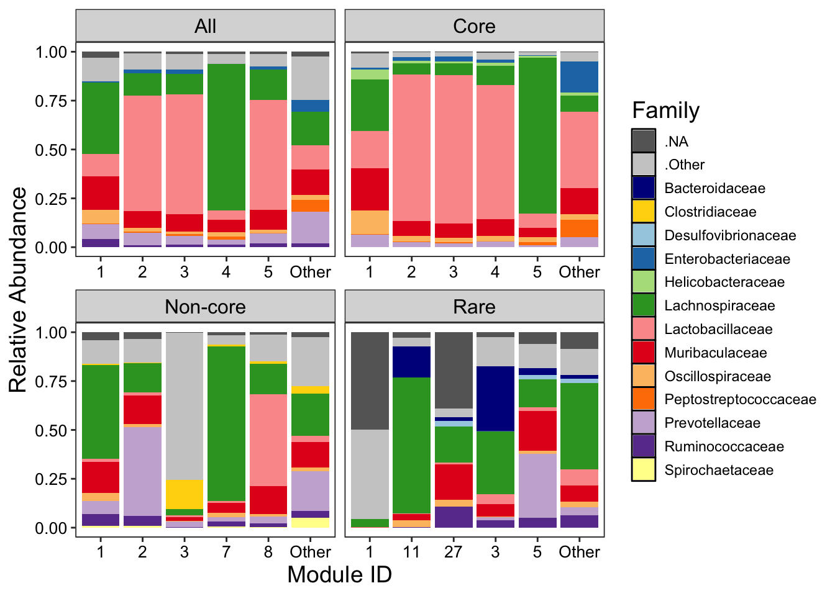
The modules capture hosts with different microbial composition
Family relative abundance
Largest 5 modules
* Differences between groups

Slide 17
What does this modular structure tell us about the processes that shaped the network?
Beta-NTI (Nearest Taxon Index)
Measures phylogenetic turnover compared to the turnover expected by chance
Raup-Crick
Measures compositional turnover compared to the turnover expected by chance
Stegen et. al., 2012; Zhou & Ning, 2017

Slide 18
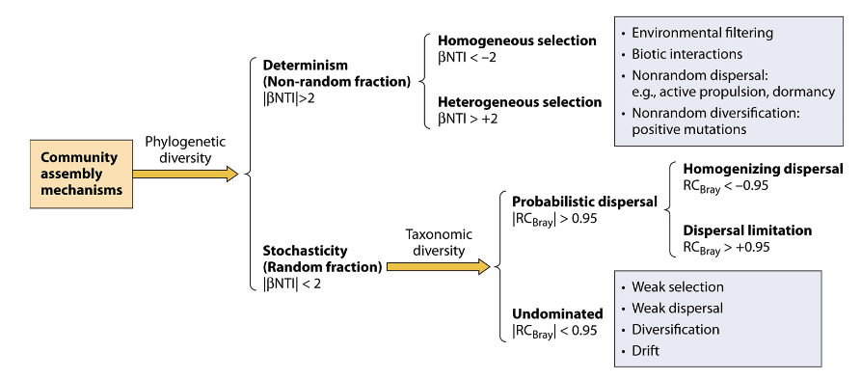
What does this modular structure tell us about the processes that shaped the network?
Stegen et. al., 2012; Zhou & Ning, 2017

Slide 19
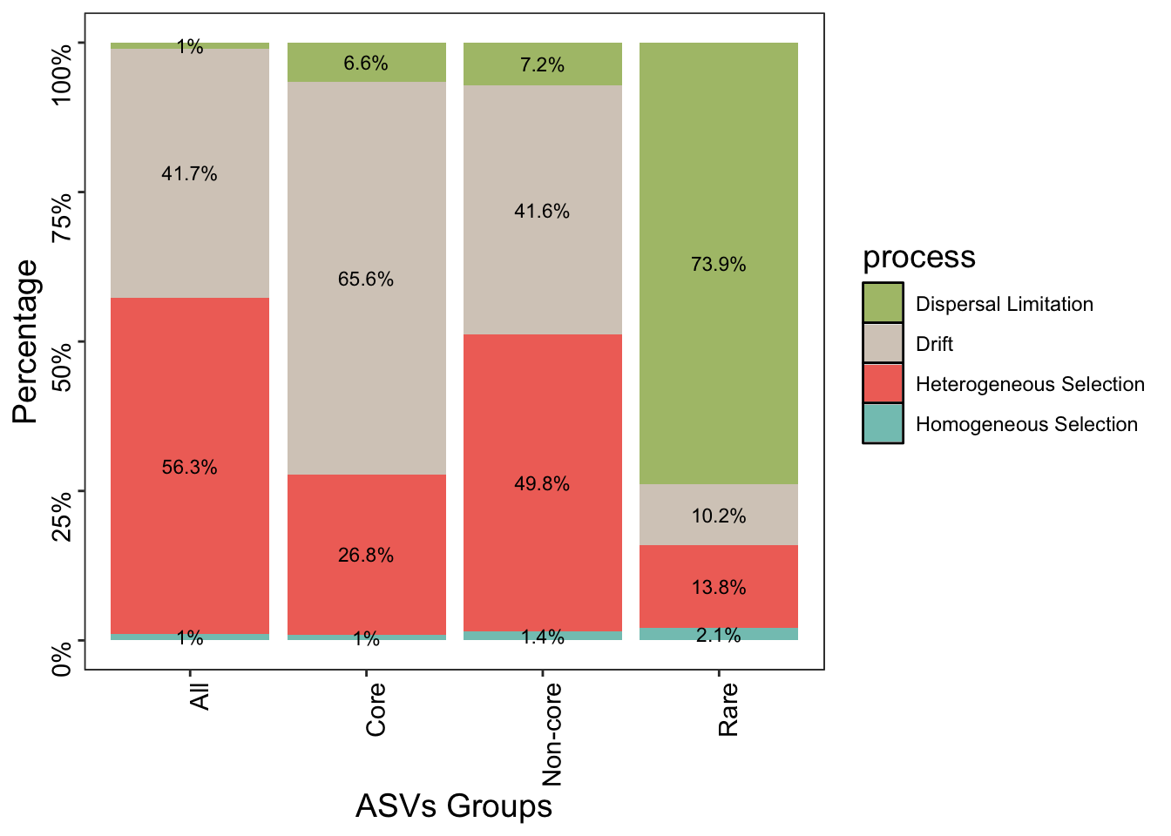
Distinct processes for prevalence groups

Slide 20
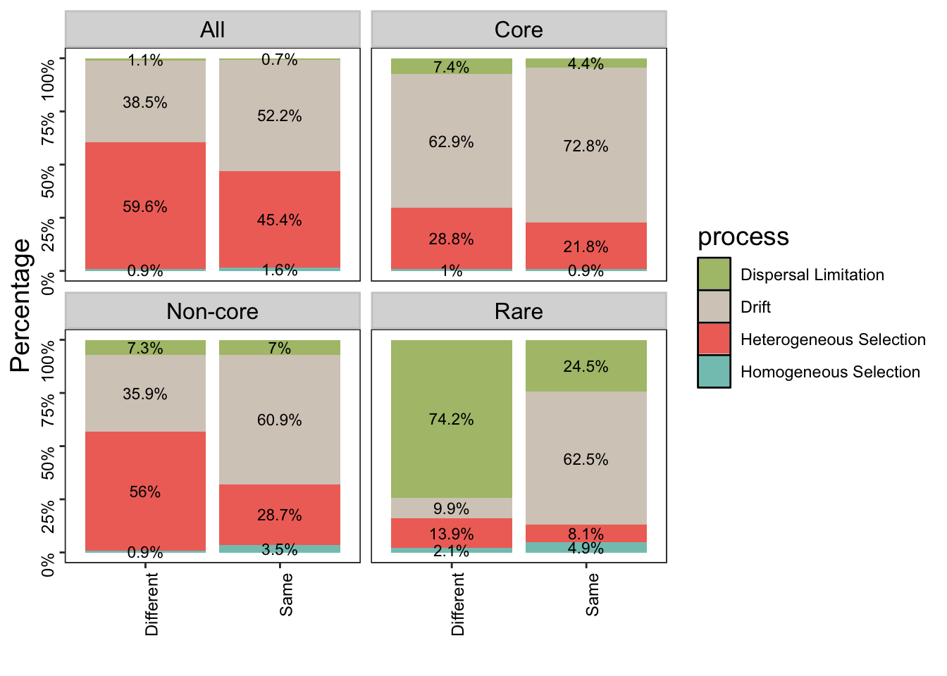
Network’s modules are indicative of the processes
Core
Neutral processes dominate the variation between hosts clustered in same and different modules

Slide 21
Network’s modules are indicative of the processes
Non-core
The modules capture selective differences between hosts
Neutral processes dominate the variation between hosts clustered in the same module

Slide 22
Network’s modules are indicative of the processes
Rare
The modules capture microbe turnover due to dispersal limitation between hosts
Neutral processes dominate the variation between hosts clustered in the same module

Slide 23
Q1.2. How does the composition of modules vary across environmental gradients?
Redundancy analysis (RDA)
Excluding the big module

Slide 24
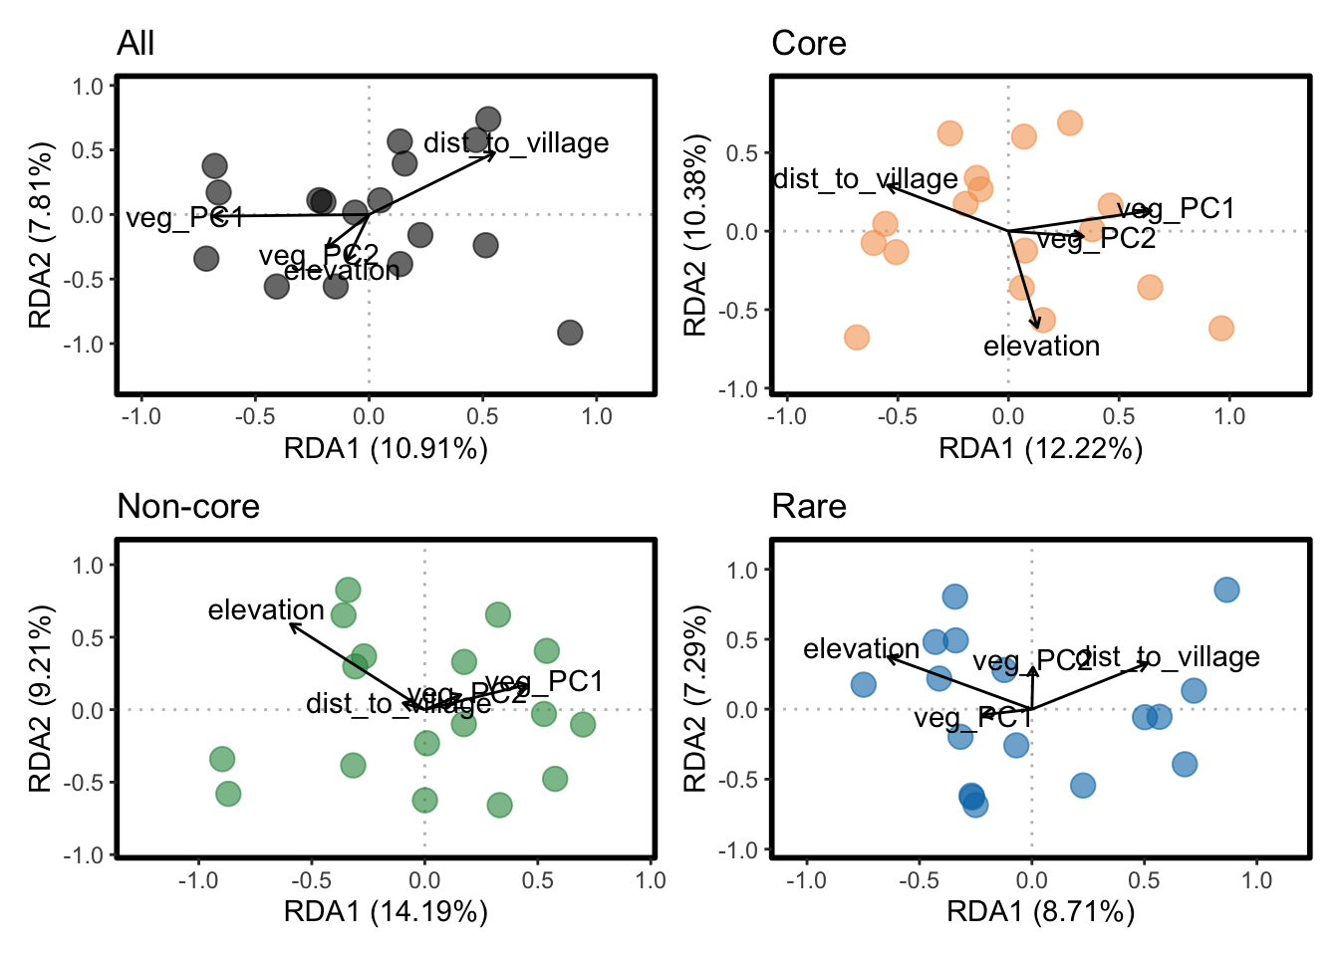
Environmental gradients explain modules variation for Non-core and Rare groups
F = 1.2, p = 0.089
F = 1.2, p = 0.229
F = 1.61, p = 0.001
Veg_PC1
Dist_to_village
elevation
F = 1.19, p = 0.013
elevation

Slide 25
Summary
Network’s modules are indicative of the processes shaping the structure
Distinct processes shape the modular structure of the prevalence groups
Core: drift
Non-core: selective (environmental filtering)
Rare: dispersal limitation
Land use has a weak effect:
Large module span all sites
Only Non-core and Rare modules vary along the environmental gradient

